Slide 1
SF Food Inspection Use Case
By: Dipesh Pokhrel

Slide 2
Introduction
Food inspection involves not only sampling and testing of end products but also assessing food centers to ensure compliance with food safety management systems. This minimizes the occurrence of public health food safety problems. Food inspection dates back to ancient times as part of the history of public health. The Food and Drug Administration (FDA) publishes the Food Code that sets guidelines and procedures to assist in food control jurisdictions. The Food Code provides a scientifically and legally backed basis for regulating the retail and food service industries.

Slide 3
Objectives
The food inspectors can then have a “Critical first” inspection approach where the places that have been predicted to have critical violations are inspected first.
Some of the factors that tend to predict critical violation include previous critical violations, high temperatures, nearby sanitation complains, nearby burglaries etc
This report would be beneficial to public health specialists and every stakeholder working to alleviate public health concerns through preventive measures.
It is not to introduce food inspection since these professionals are already carrying out food inspections in the relevant jurisdictions but to make the process more efficient.

Slide 4
Data Description
After conducting an inspection of the facility, the Health Inspector calculates a score based on the violations observed. Violations can fall into:
  High risk category: records specific violations that directly relate to the transmission of food borne illnesses, the adulteration of food products and the contamination of food-contact surfaces.
  Moderate risk category: records specific violations that are of a moderate risk to the public health and safety.
  Low risk category: records violations that are low risk or have no immediate risk to the public health and safety.

Slide 5
Data Description
# | Feature Name | Description
1 | business_id | Unique number used for identification of the business
2 | business_name | Business Name
3 | business_address | The address of the business
4 | business_city | The City (here all records have the same city San-Francisco)
5 | business_state | The state (here all records have the same state CA)
6 | business_postal_code | Zip/postal code of the business
7 | business_latitude | The latitude value of the business location
8 | business_longitude | The longitude value of the business location
9 | business_location | A tuple of the latitude and the longitude values
10 | business_phone_no | Business phone number
11 | inspection_id | Unique number that identifying the inspection case
12 | inspection_date | The date of the inspection process
13 | inspection_score | A score out of 100 that the business got after the inspection
14 | inspection_type | Routine-Unscheduled, complaint, New ownership, new construction or Non-inspection site visit. In our dataset this feature has only one value “Routine-Unscheduled”
15 | violation_id | Identification of violation
16 | violation_description | Short description of the violation if any
17 | risk_category | Classification of the business category, Low, Moderate or High Risk

Slide 6
Methodology
Collect Inspection Data
Explore and Understand the Data
Data preparation and preprocessing
Modeling
Evaluation and Testing

Slide 7
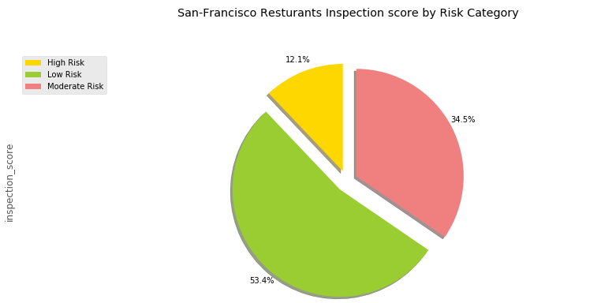
Results: Inspections In general

Slide 8
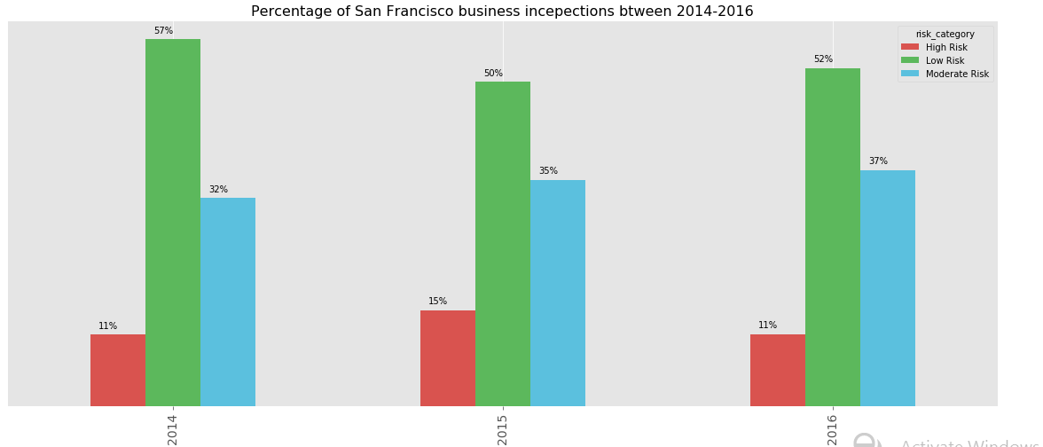
Results: Inspections by year

Slide 9
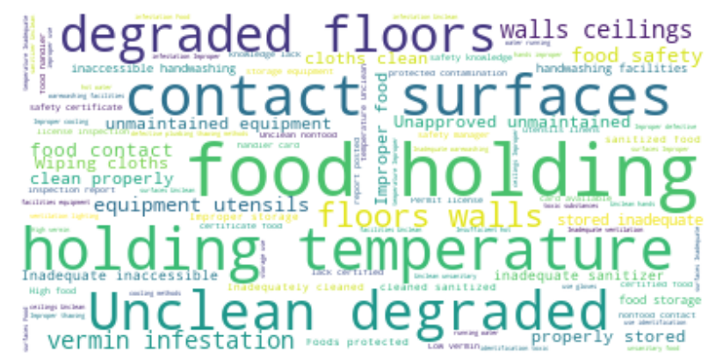
Violation description cloud words

Slide 10
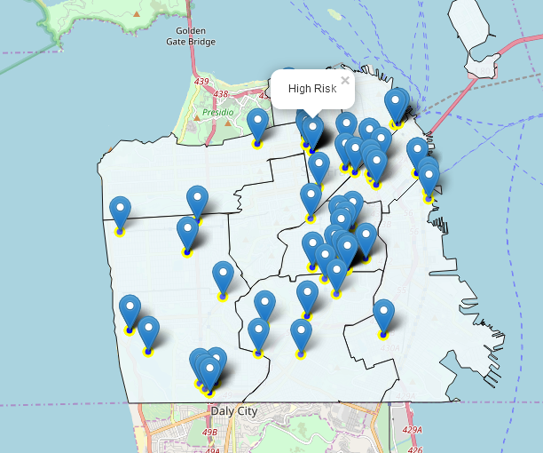
visualize the locations of the inspections
In order to reduce computational cost, let's just work with the first 100 inspections in this dataset.

Slide 11
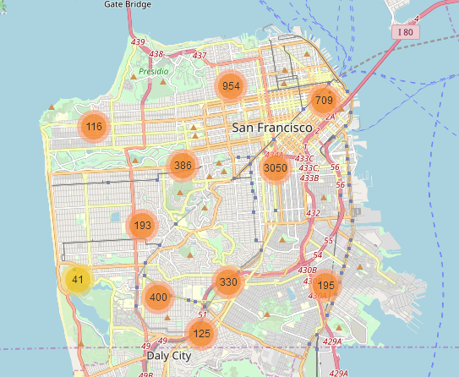
A clean and categorized copy of the map of San Francisco

Slide 12
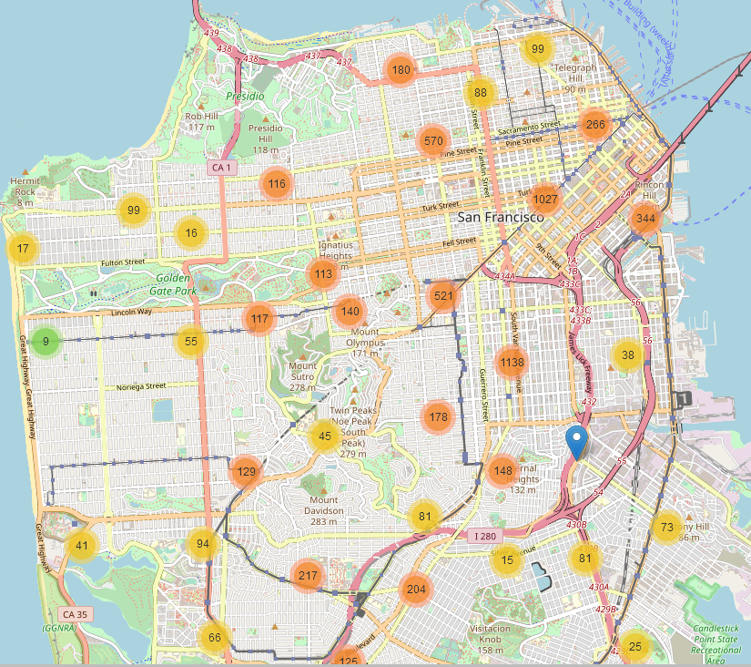
A clean and categorized copy of the map of San Francisco (more details)

Slide 13
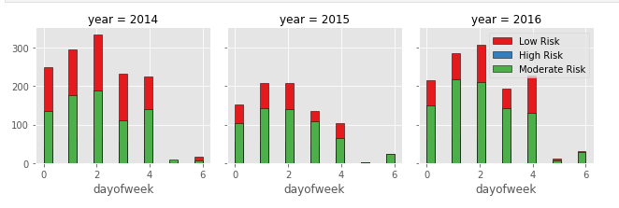
Inspection activities days of the week

Slide 14
Machine learning Algorithm results
 | kNN | LR
Train set Accuracy | 0.6332499518953242 | 0.5358860881277661
Test set Accuracy | 0.5215384615384615 | 0.5246153846153846
F1 Accuracy | 0.47777033142713926 | 0.36103702553753003

Slide 15
using Foursquare to analyze the neighborhood of the inspected businesses
In order to reduce computational cost, let's just work with the first 100 inspections in this dataset
We choose “OMNI S.F. Hotel” it is Low Risk business inspection and it got 96 score

Slide 16
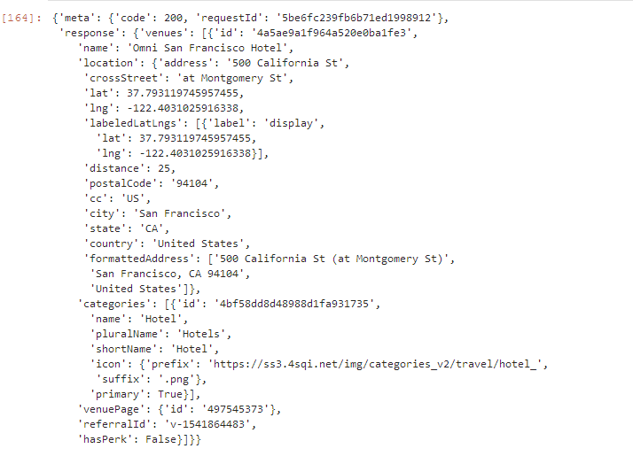
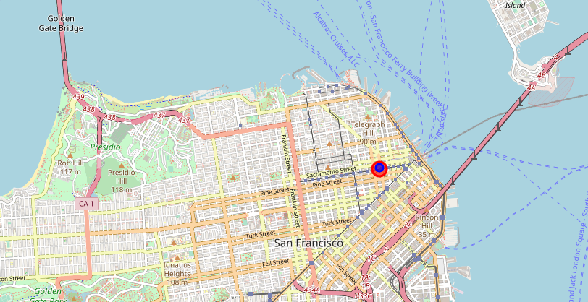
“OMNI S.F. Hotel” Venues data and location

Slide 17
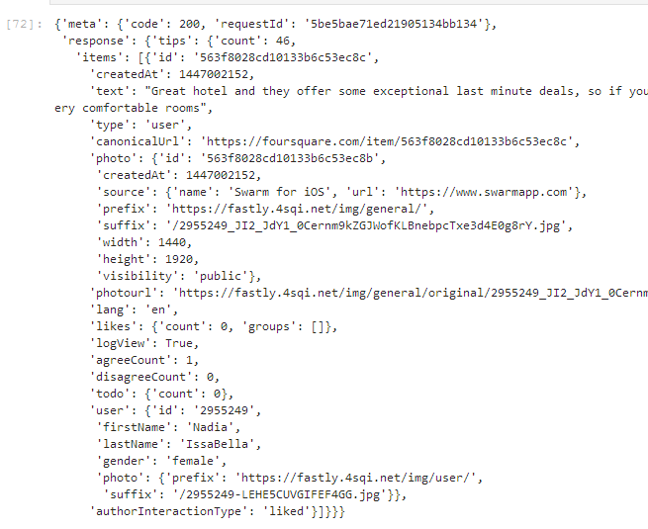
Foursquare API gives us we are able to only show one tip
Example of one tip

Slide 18
Foursquare User
We also examine the user who made that tip and we found that:
  She is female
  Here first name is Nadia and Last Name: IssaBella, Home City: Vaughan, Canada
  Nadia is very active in Foursquare as we can see she has 598 tips. Let us explore them.

Slide 19
Conclusion
To promote health, stakeholders in the healthcare industry need to continuously innovate to make the process more efficient. In food inspection, technology can be used to predict a likely critical violation through the use of data analytics instead of inspecting every joint blindly given the lack of enough manpower for this. The data used to predict critical violation include weather, crime and inspection data. Afterward, places data e.g. Foursquare is used to locate the food establishment for physical inspection

